Slide 1






ORAL
CANCER
Prediction model.
Supervised by Eng. Mahmoud Talaat

Slide 2

OUR TEAM
MOHAMED GAMAL ELDEEN
AI & DevOps & API Integration
SHAIMAA MOSTAFA SOLIMAN
AI & ML Engineer
HABIBA HAKKI
Data Scientist & ML Engineer
ZEIAD SAHER
AI & ML Engineer
NADA MOHAMED
AI & ML Engineer
ROWAIDA KHALED
Data Analyst & ML Engineer

Slide 3


CONTENT
1
2
3
Introduction
Problem statement
Proposed solution
4
5
6
Methodology
Machine learning results
Conslusion

Slide 4

01
INTRODUCTION

Slide 5

INTRODUCTION
Oral cancer is often detected late, leading to high mortality and treatment cost. Traditional diagnosis depends on manual clinical exams, which are slow and can miss early signs. There is a need for a fast, accurate, automated way to predict cancer stage using patient data.
We built a machine-learning system that predicts oral cancer stage using clinical and patient features. The workflow includes data preprocessing, feature selection, training 6 ML models, tuning hyperparameters, and building a final Voting Classifier. The model is deployment-ready with API integration for real-time predictions.
Our system provides accurate and explainable predictions, improves early detection, and supports doctors with data-driven insights. It uses multiple optimized models, handles class imbalance effectively, and offers a robust ensemble model ready for clinical deployment.

Slide 6
02
PROBLEM
STATEMENT

Slide 7
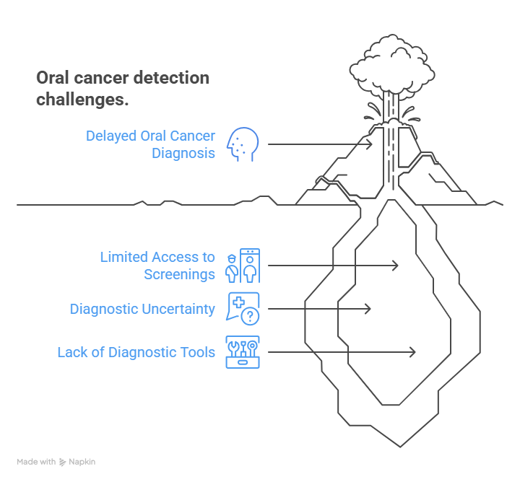
PROBLEM STATEMENT
Early detection of oral cancer is challenging because many high-risk individuals lack access to regular screenings, early symptoms often resemble harmless conditions leading to missed diagnoses, and frontline healthcare workers frequently lack specialized tools for quick assessment. These limitations highlight the need for an accessible, intelligent system that supports early recognition and empowers both individuals and clinicians to act promptly.

Slide 8
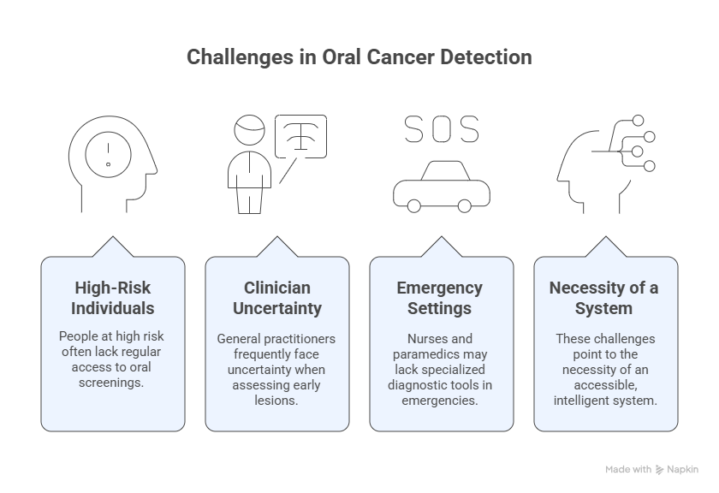
PROBLEM STATEMENT

Slide 9
03
PROPOSED SOLUTION

Slide 10
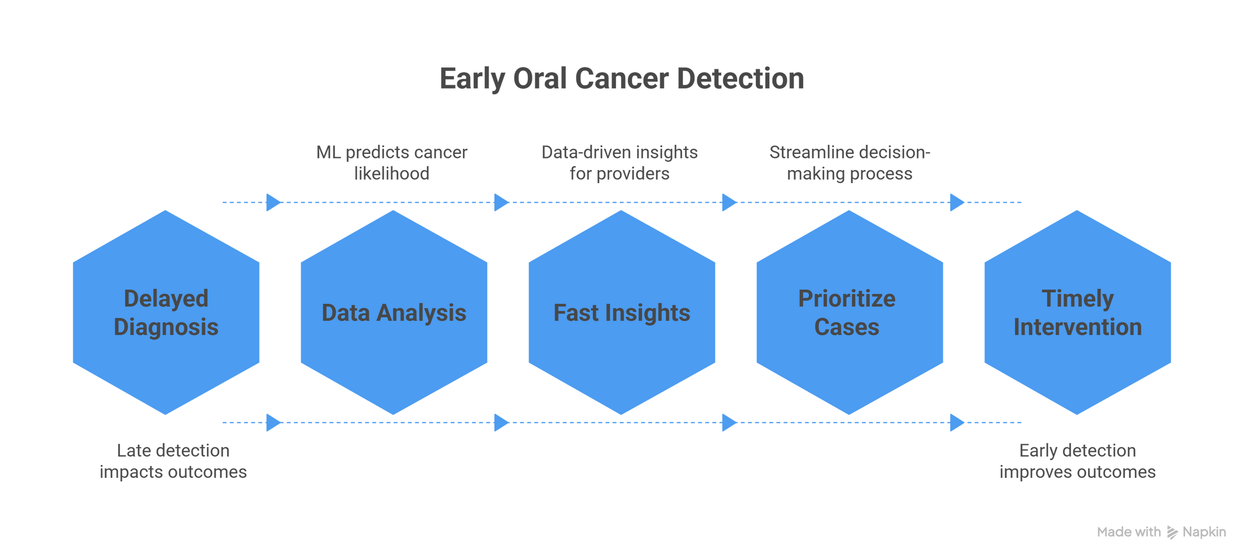
MACHINE-LEARNING–BASED ORAL CANCER PREDICTOR
The solution is an intelligent diagnostic tool that leverages machine learning and deep learning to analyze diagnostic data and predict the likelihood of oral cancer. The system is designed to assist healthcare providers by offering a non-invasive, accessible, and accurate early-detection aid.

Slide 11
04
METHODOLOGY

Slide 12
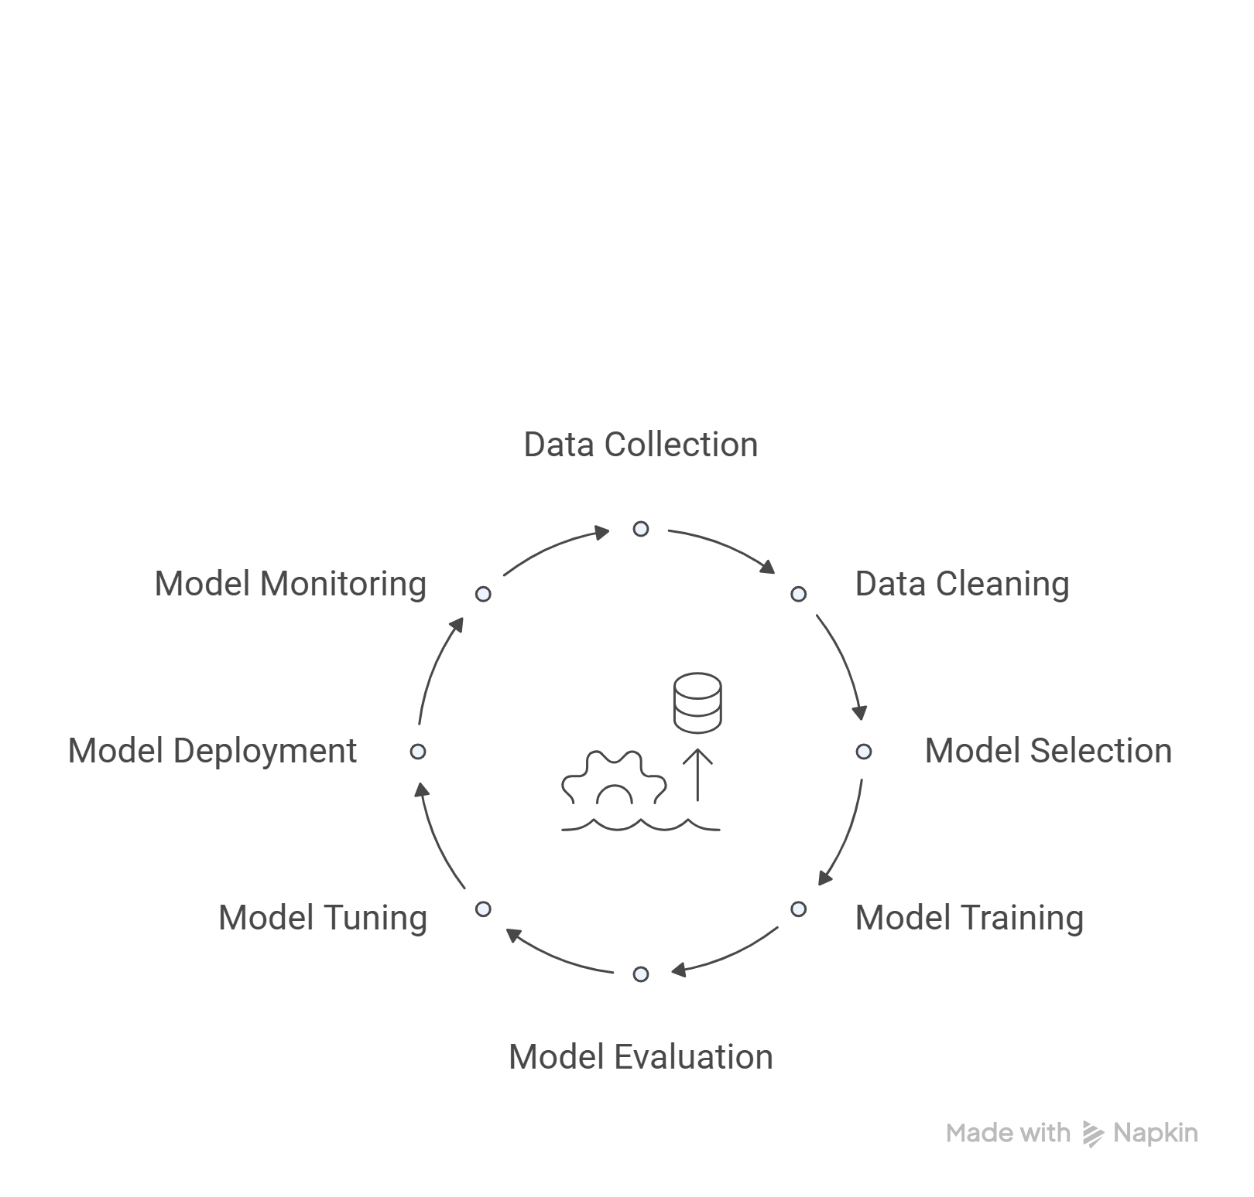

Slide 13
DATA COLLECTION
Kaggle Dataset: https://www.kaggle.com/datasets/ankushpanday2/oral-cancer-prediction-dataset/data
Basic statistics:
• Rows: 84,922
• Columns: 30
• Data Types: 10 numeric (int32/64, float64), 19 categorical (object), 1 date (datetime64)
• Memory Usage: Approximately 18.5 MB
The dataset spans a diverse population, with ages ranging from 18 to 90 years (mean ~50.46), and includes representation from countries like Italy, Japan, UK, Sri Lanka, South Africa, USA, Taiwan, and Pakistan (based on samples).

Slide 14
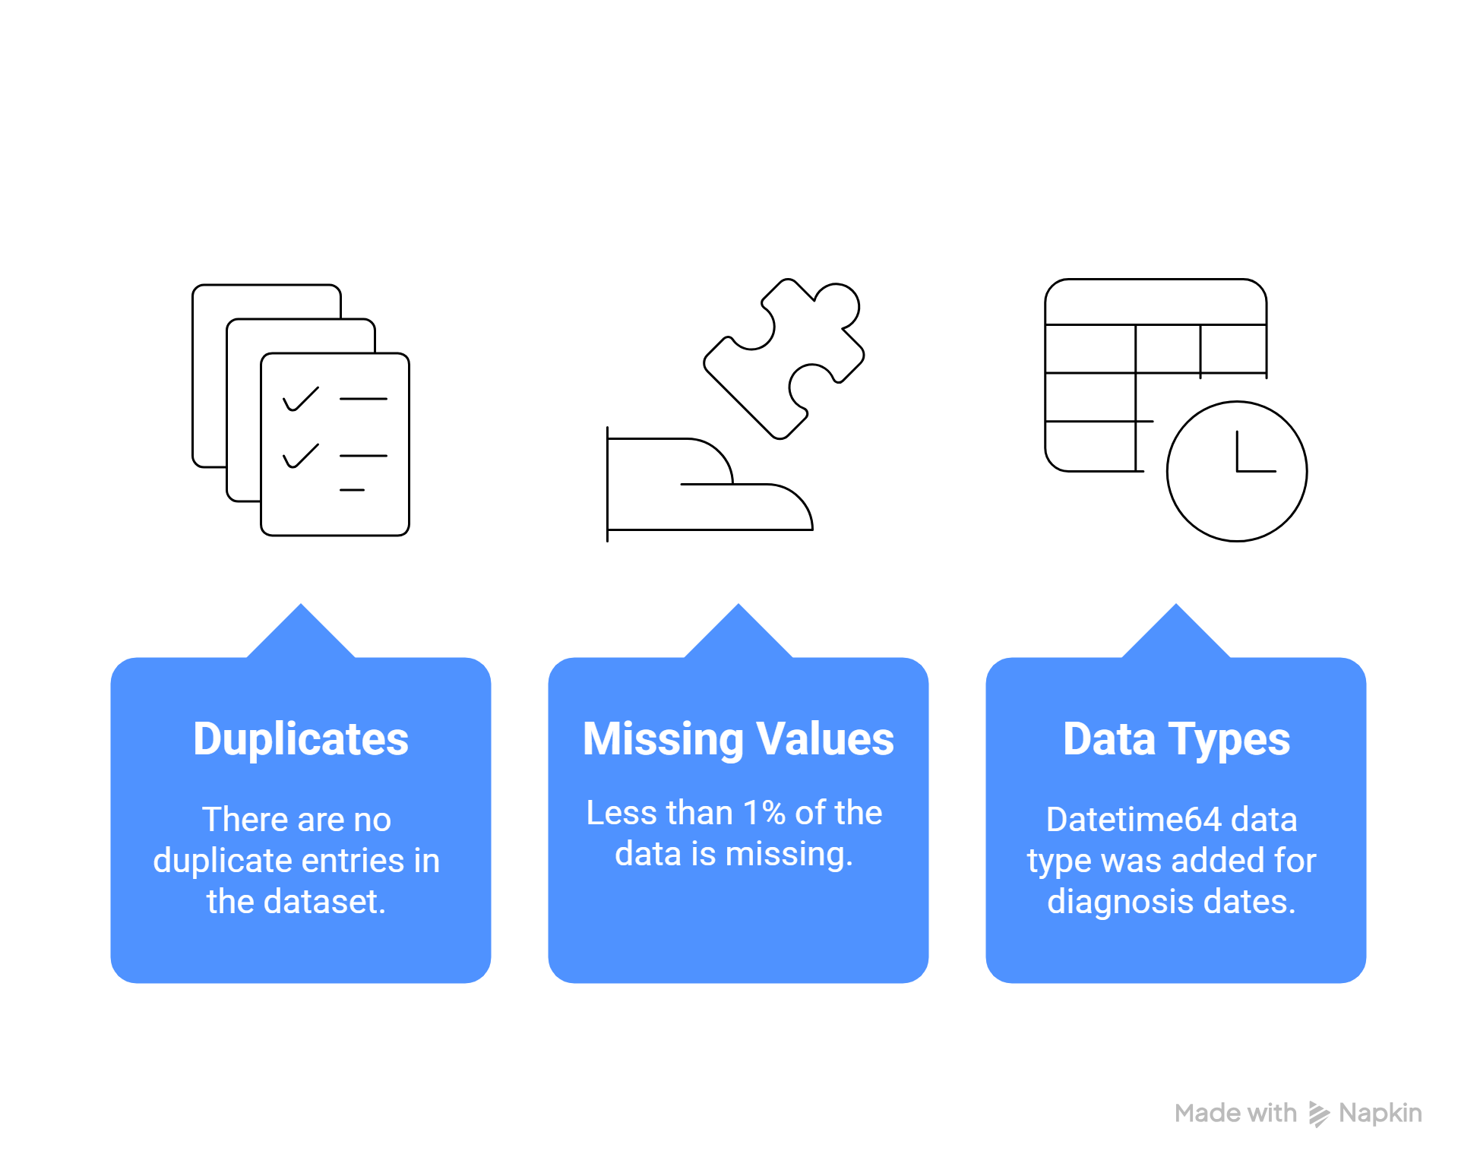
DATA CLEANING

Slide 15

FEATURE ENGINEERING
• Derived Columns:
o Predicted_LOS(Days): Cancer Stage*1 + Treatment_LOS +
Immune*3 + Age/20 + Tumor Size*0.25 + Diet_LOS +
(Tobacco+Alcohol)*1 - Early*5.
o Predicted_Recovery(Days): Cancer Stage*20 +
Treatment_Recovery + Immune*10 + Age*0.3 + Tumor Size*1.2 +
Diet_Recovery + (Tobacco+Alcohol)*6 - Early*30.
o Date_of_Diagnosis: Probabilistic year selection (2018-2024) with
weights, random day within year.
o Year_of_Diagnosis: Extracting Year from Date_of_Diagnosis.
o Age_Group: Classification Age column into 5 categories

Slide 16
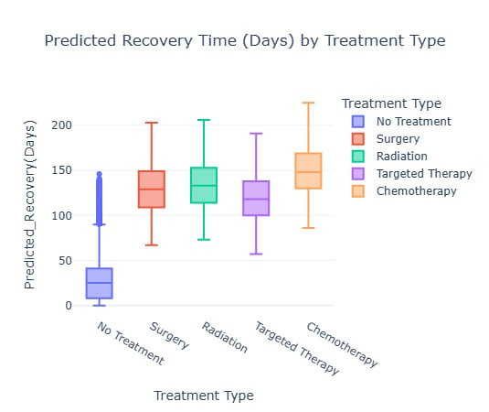
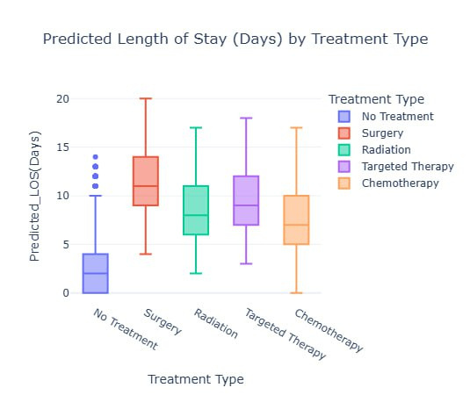
EXAMPLES:

Slide 17
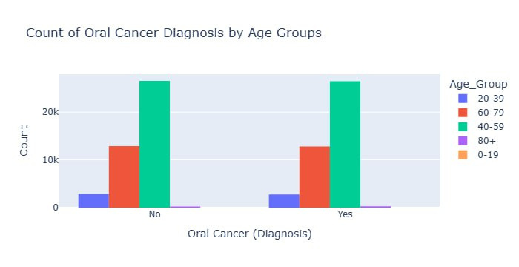

CANCER DIAGNOSIS ACCORDING TO AGE GROUP

Slide 18

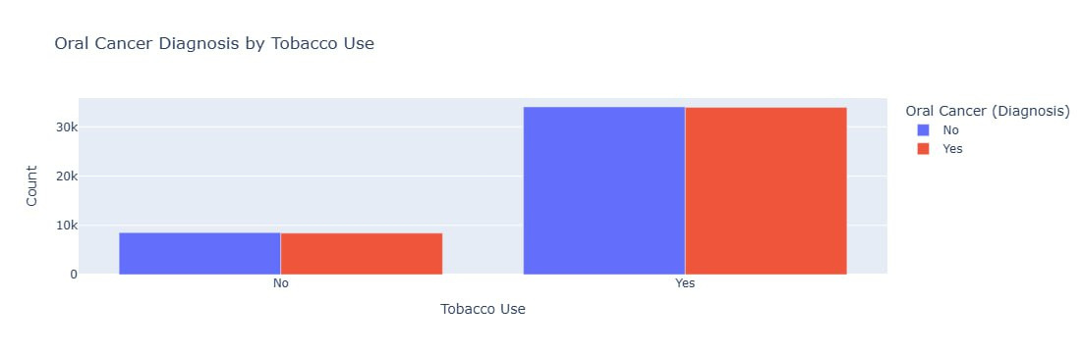
FACTORS AFFECTING DIAGNOSIS

Slide 19
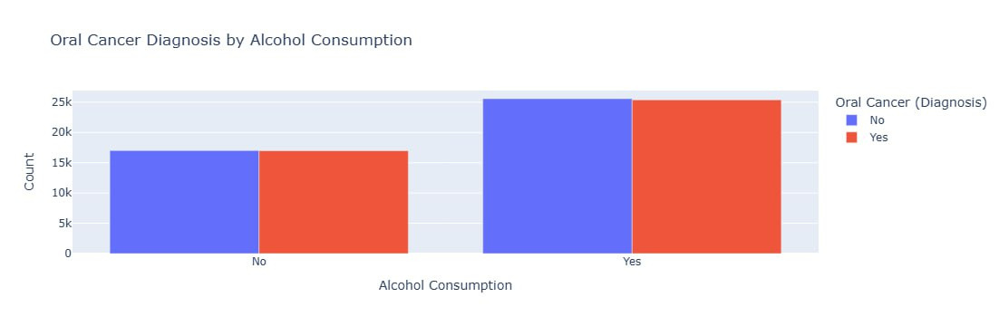
FACTORS AFFECTING DIAGNOSIS

Slide 20
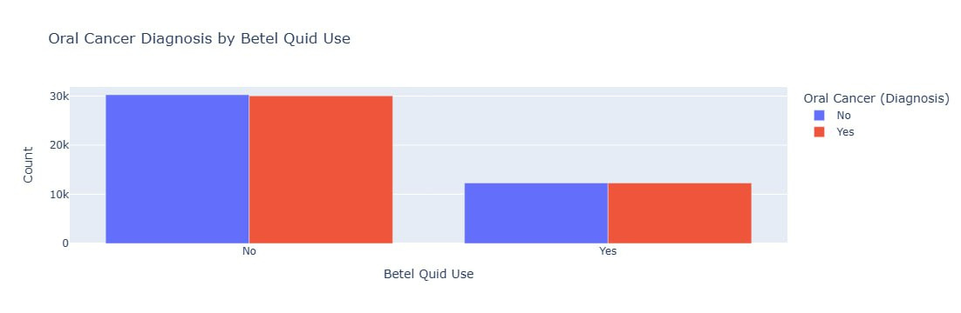
FACTORS AFFECTING DIAGNOSIS

Slide 21
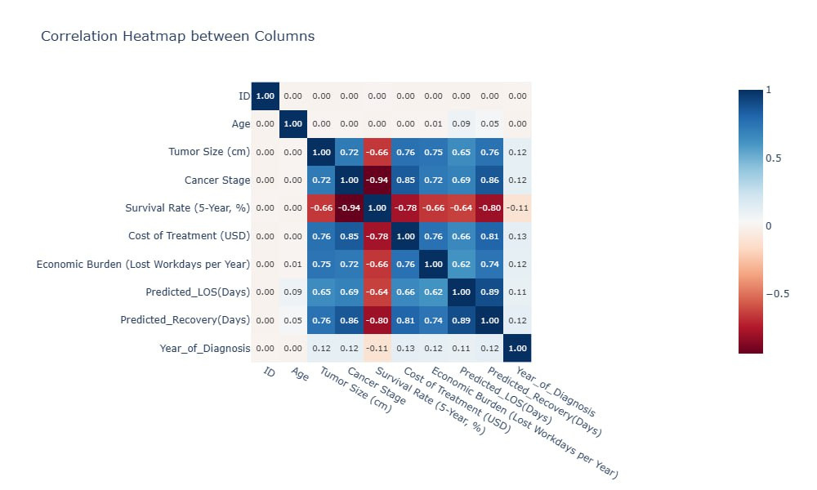
CORRELATION BETWEEN COLUMNS

Slide 22
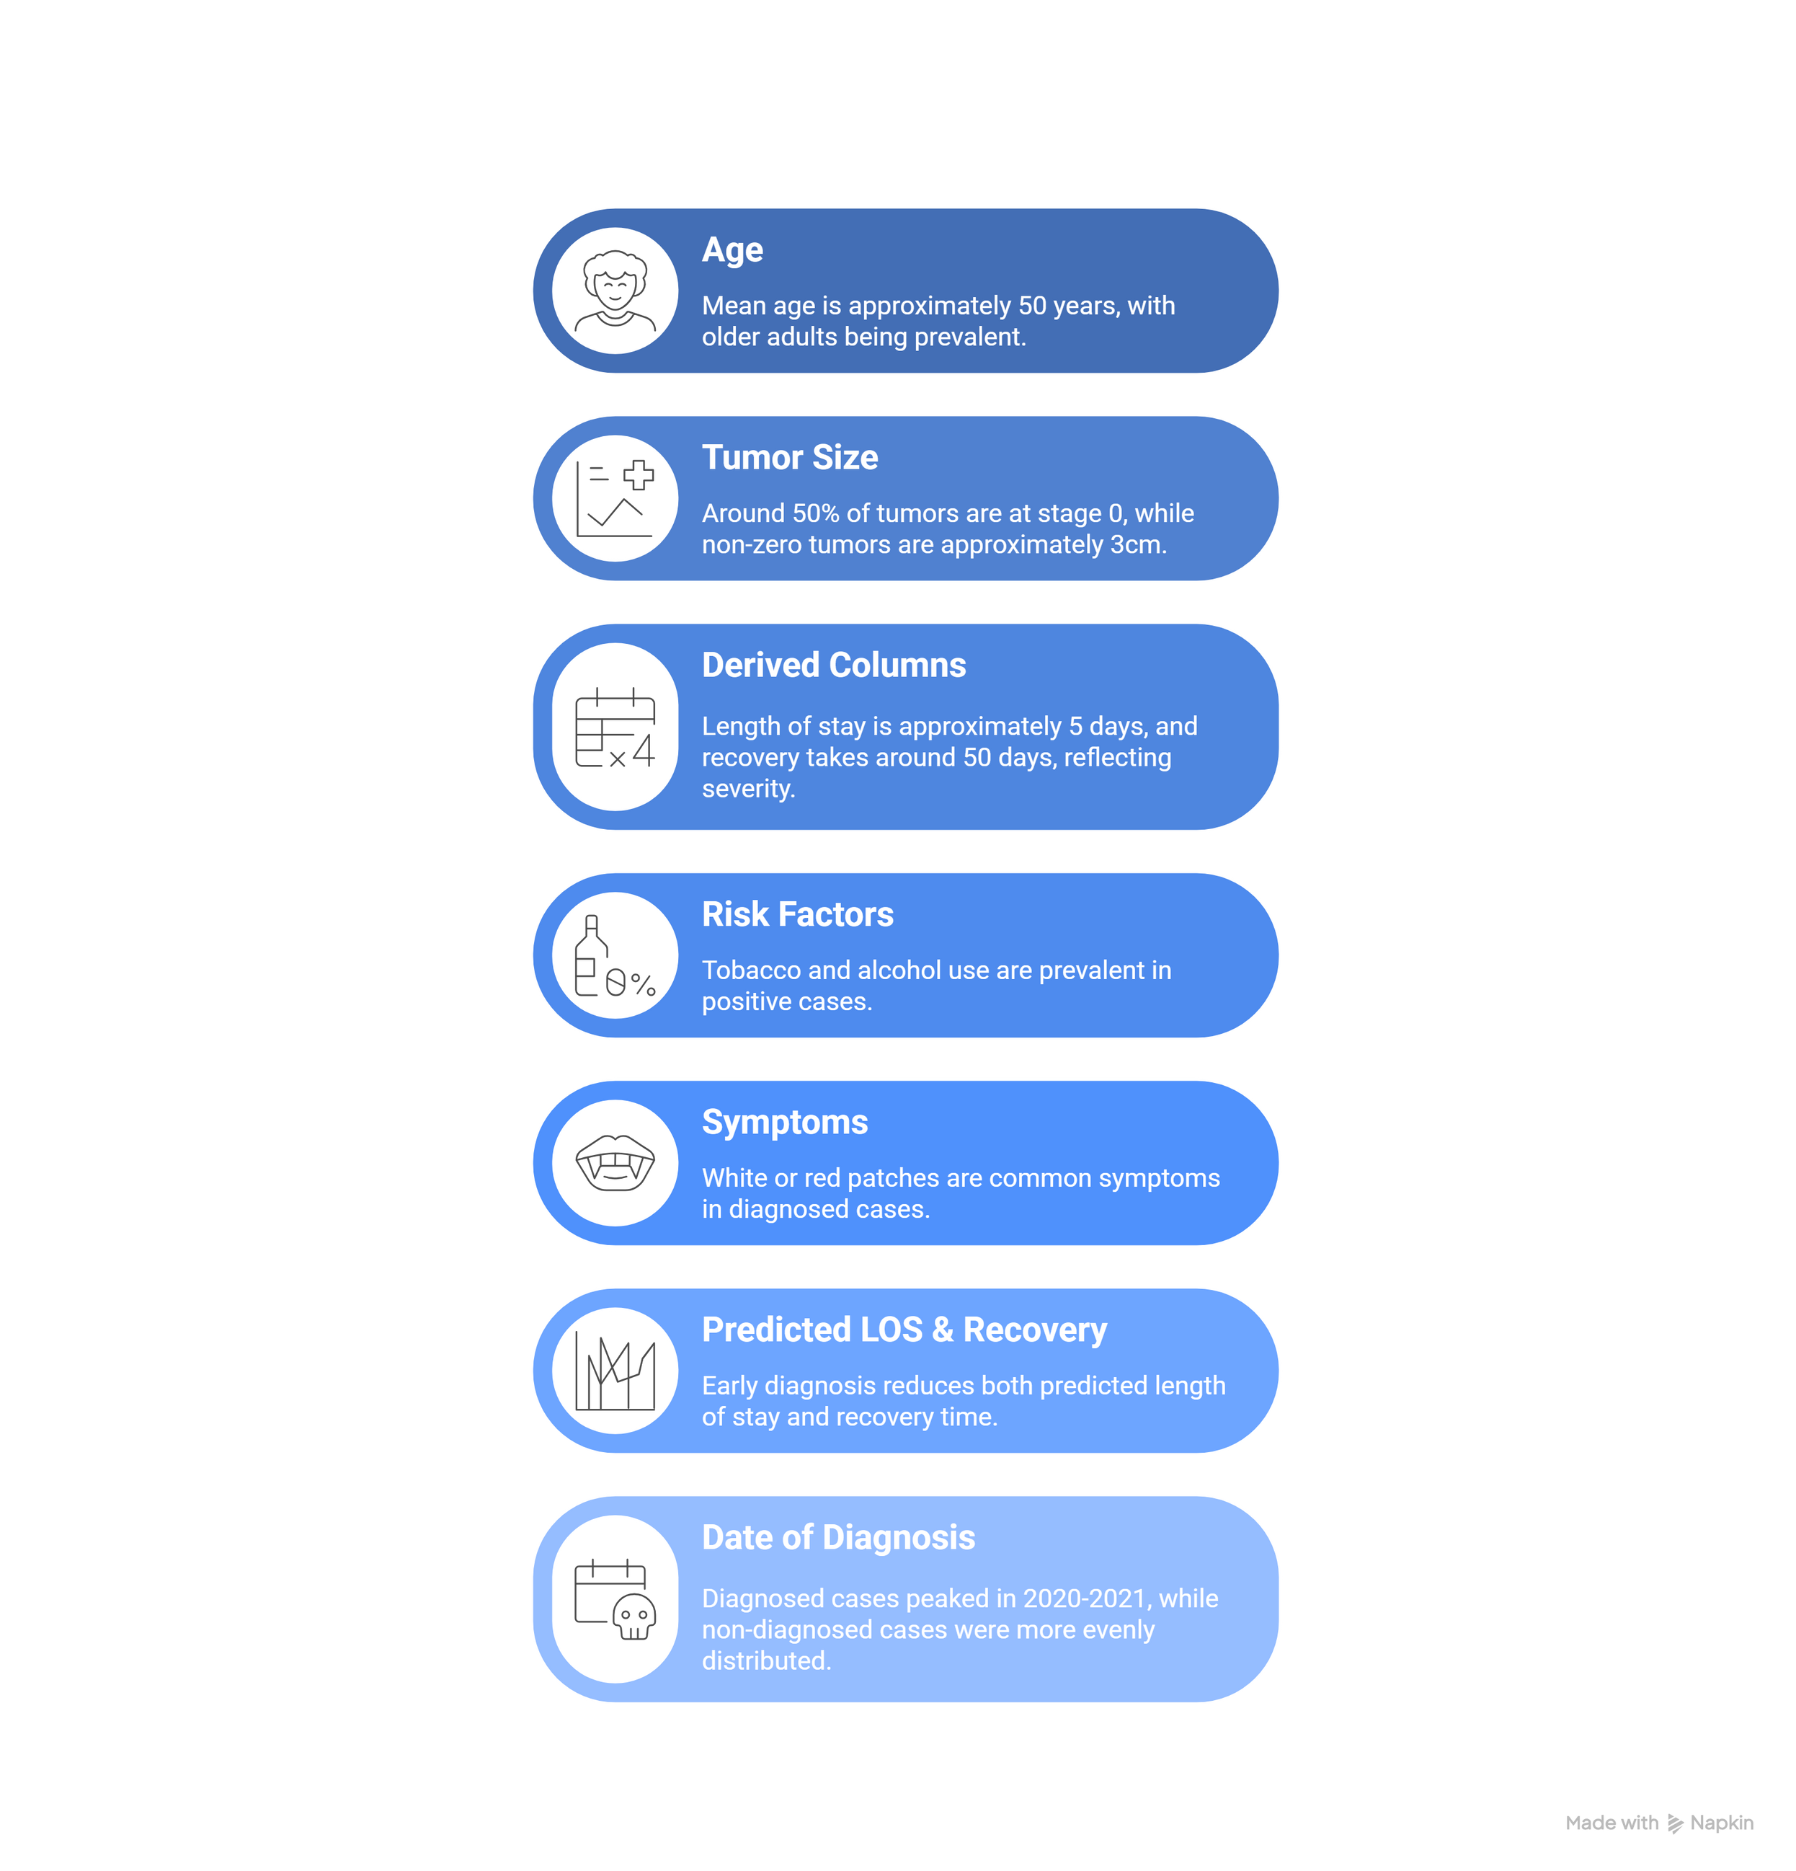
KEY INSIGHTS:

Slide 23
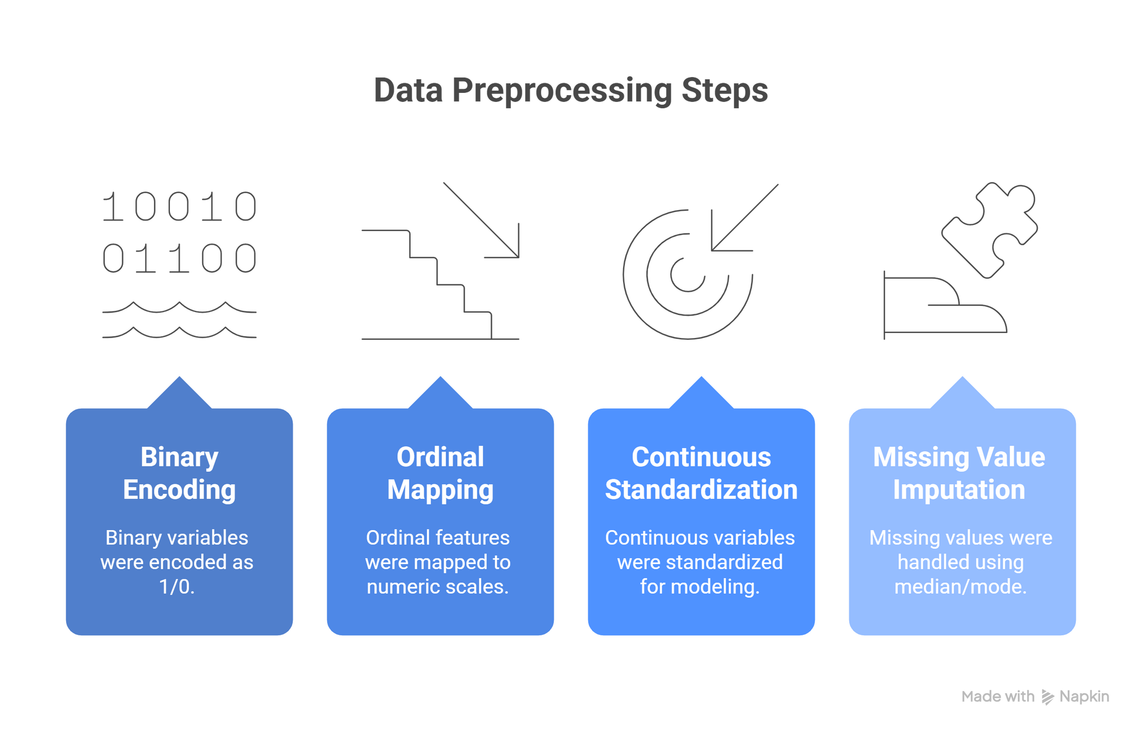
DATA PREPROCESSING

Slide 24
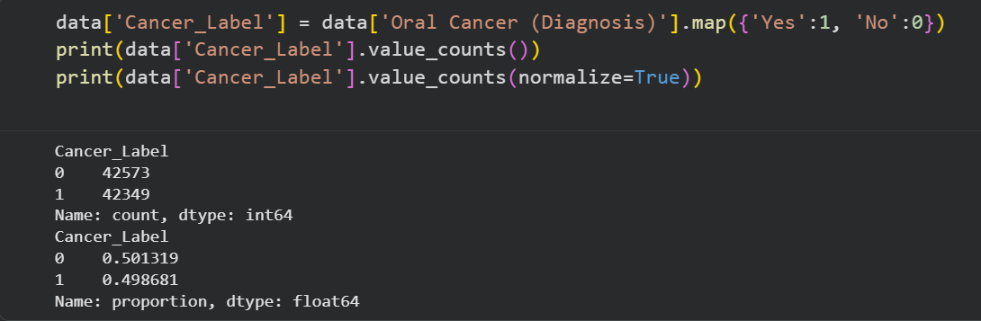
EXAMPLE:
This code converts the “Oral Cancer (Diagnosis)” column from text labels into numerical values so it can be used in machine-learning models. It then displays both the raw counts and the percentage distribution of the new cancer-label classes to show how balanced the dataset is.

Slide 25
05
MACHINE- LEARNING RESULTS

Slide 26


ABOUT THE MODELS
Our system includes five machine-learning models that support key clinical decisions. The Cancer Label model identifies the likelihood of oral cancer, while the Predicted Recovery, Predicted Length of Stay, and Survival Rate models estimate patient outcomes throughout the care process. The Cost Model forecasts expected treatment expenses. Together, these models provide a comprehensive, data-driven view that enhances early detection, patient management, and healthcare planning.

Slide 27
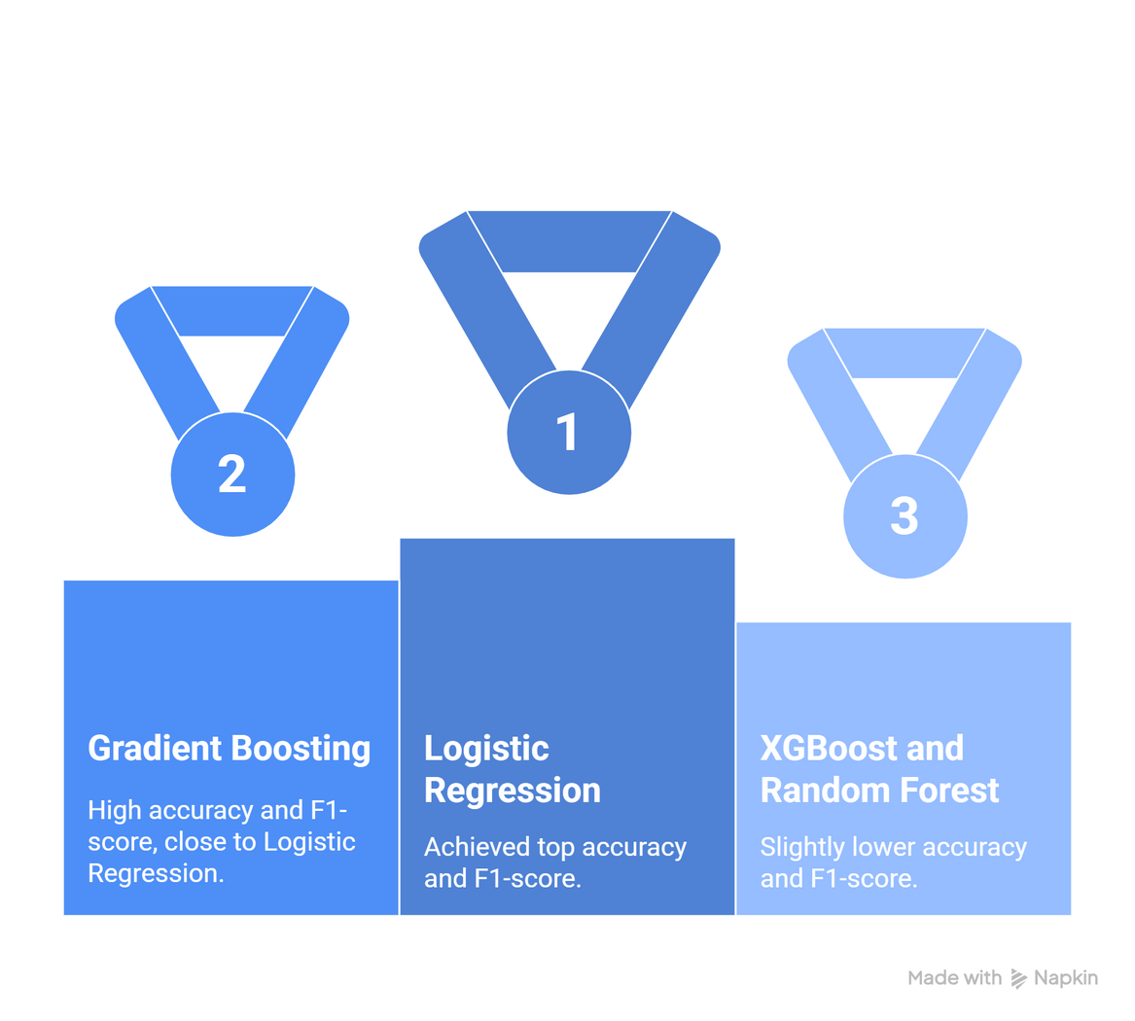
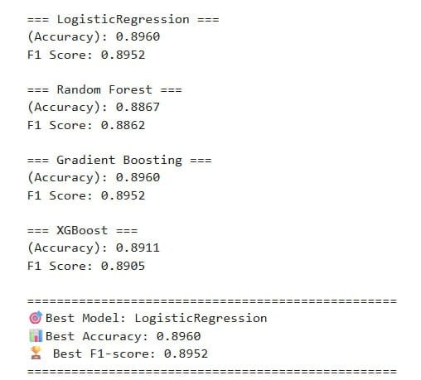
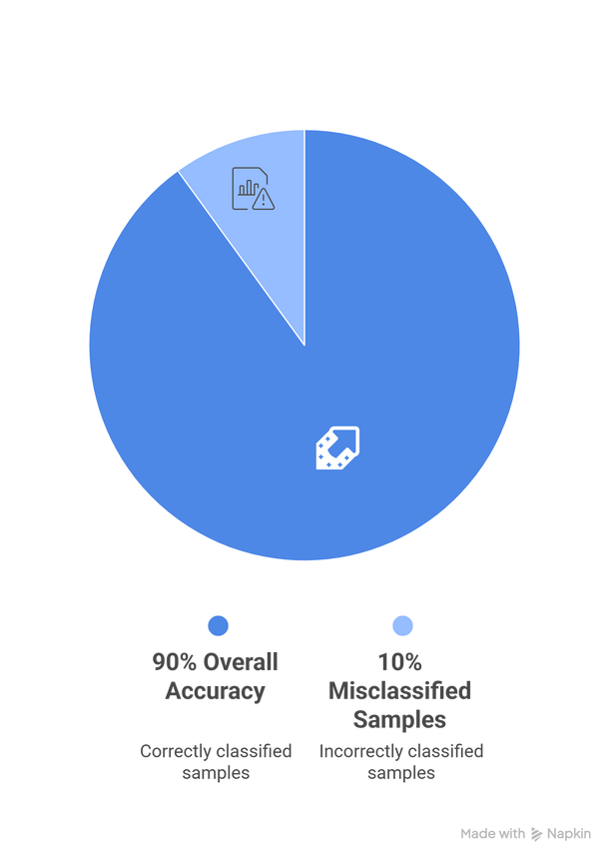
CANCER LABEL MODEL
Logistic Regression is the best-performing model.
accuracy: 89.6%
F1-score: 0.8952

Slide 28
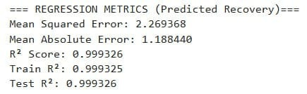
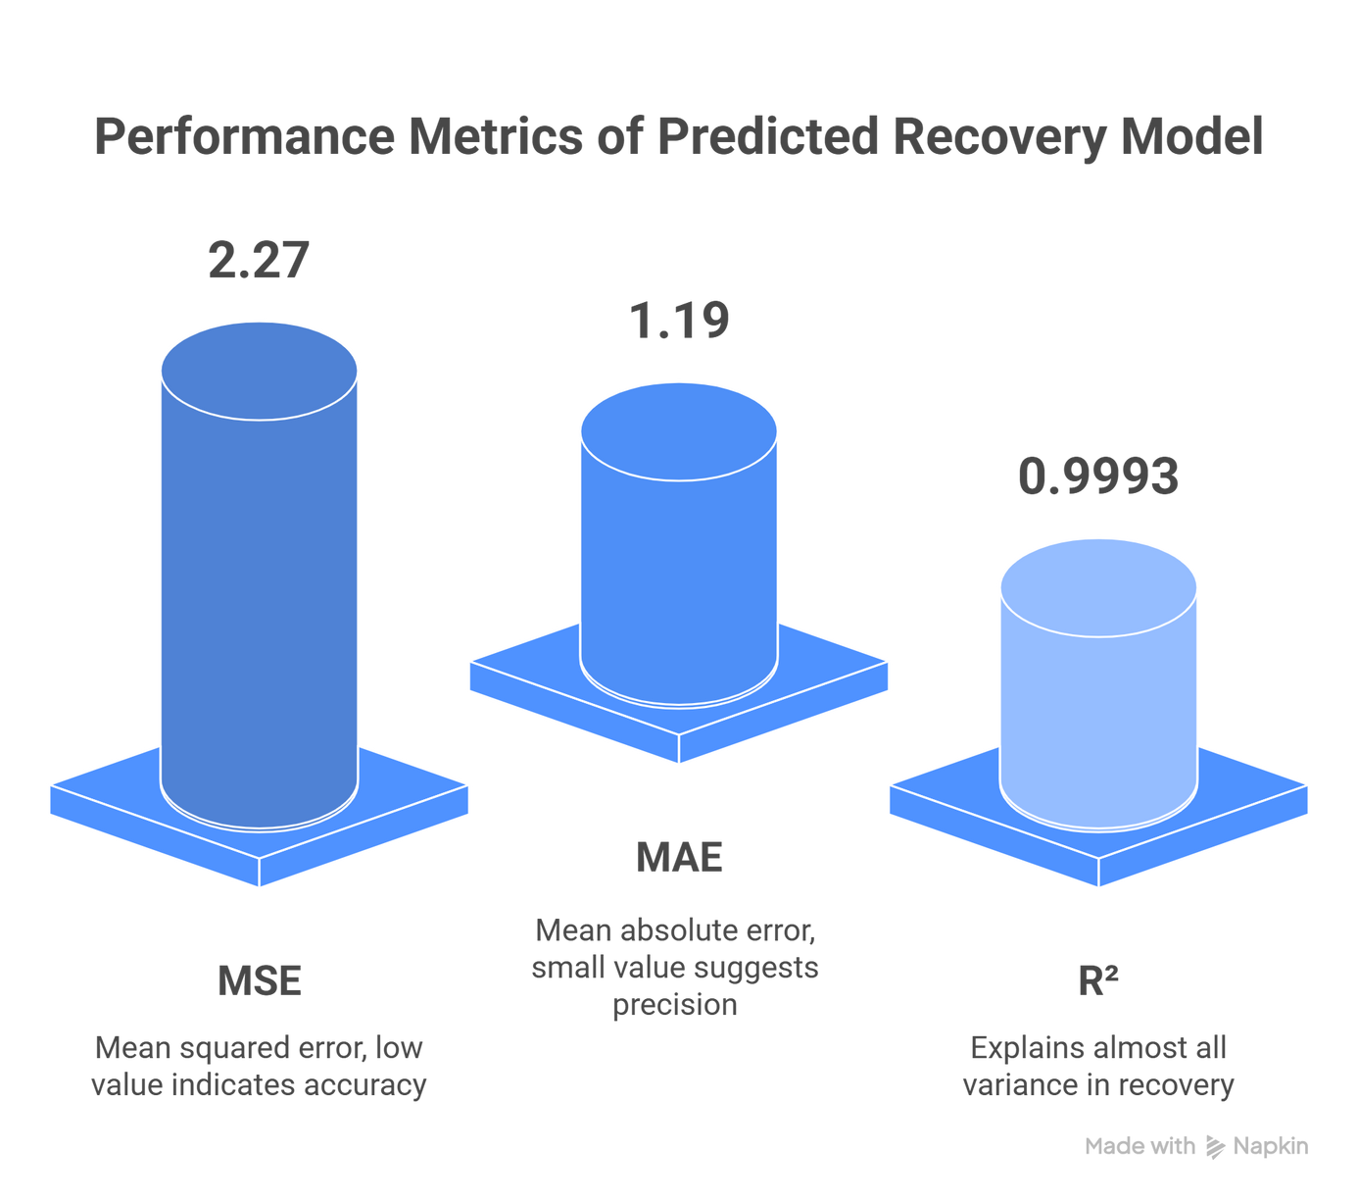
PREDICTED RECOVERY MODEL
Excellent performance with extremely low error values and a near-perfect fit. The MSE (2.27) and MAE (1.19) indicate that prediction errors are very small, while the R² score of 0.9993 shows that the model explains almost all the variance in recovery outcomes. The nearly identical train and test R² scores confirm that the model generalizes well and is not overfitting.

Slide 29
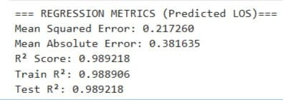
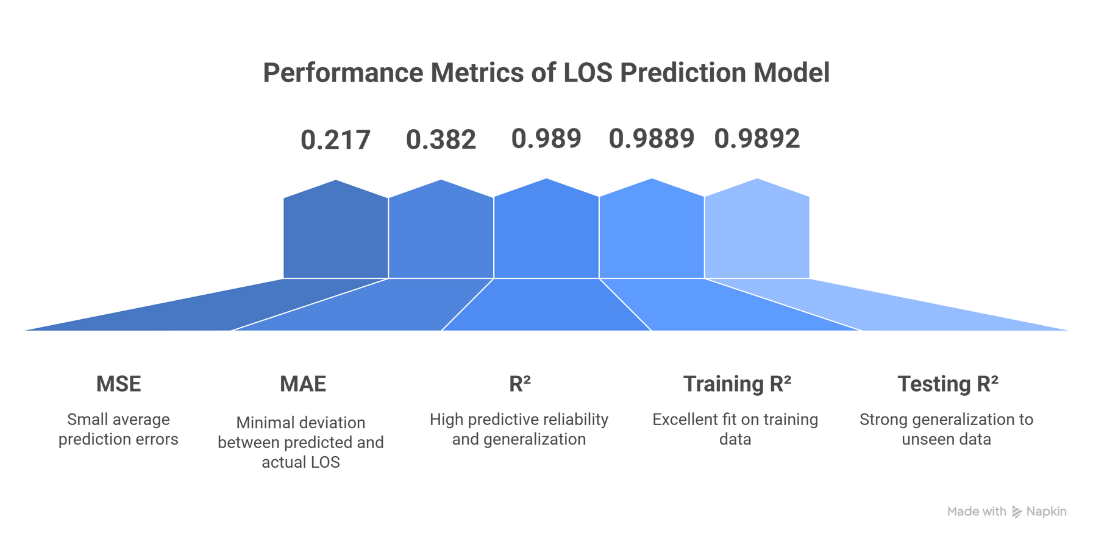
PREDICTED LENGTH OF STAY MODEL
The Mean Squared Error (MSE) is 0.217, indicating that prediction errors remain very small on average. The Mean Absolute Error (MAE) of 0.382 reinforces this, reflecting minimal deviation between predicted and actual LOS values. The model achieves an R² score of 0.989, with nearly identical results on both training (0.9889) and testing (0.9892) sets—clear evidence of excellent generalization and high predictive reliability.

Slide 30
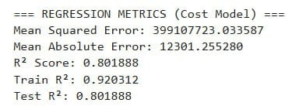
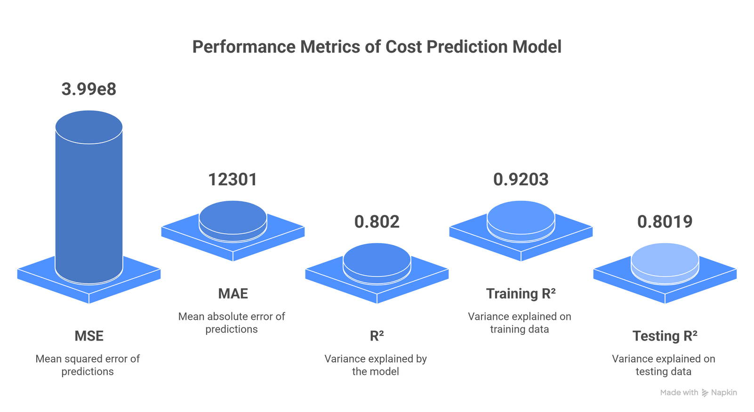
COST MODEL
The MSE of ~3.99×10⁸ and MAE of ~12,301 indicate sizeable absolute errors, which are expected when predicting high-magnitude cost values. The R² score of 0.802 reflects that the model explains roughly 80% of the variance in actual costs. The gap between training (0.9203) and testing (0.8019) R² suggests some degree of overfitting, though the model still generalizes reasonably well to unseen data.

Slide 31
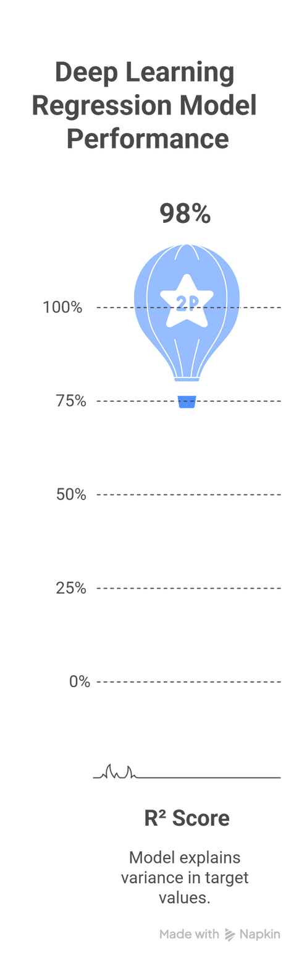
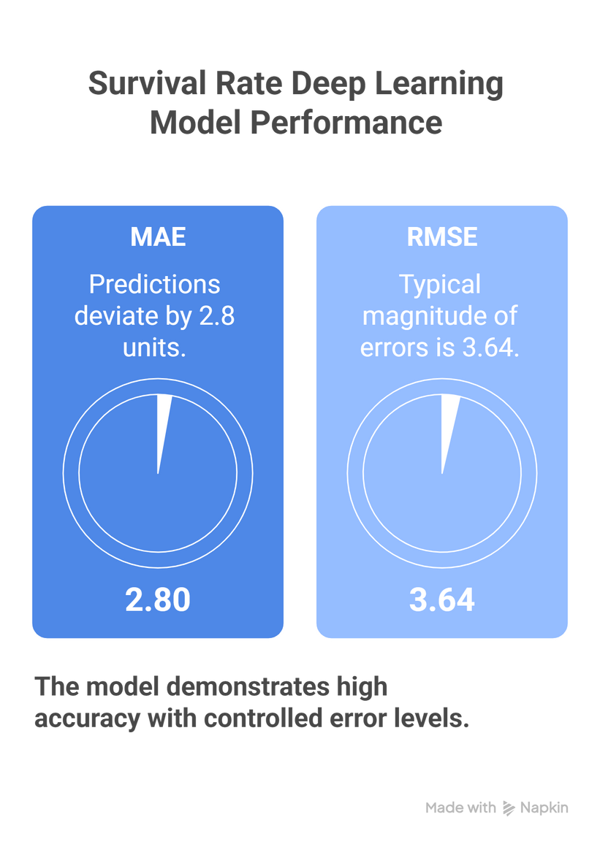
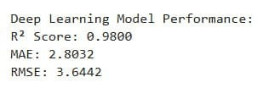
SURVIVAL RATE MODEL
Deep Learning Regression
MLP (Multi-Layer Perceptron)
The deep learning regression model shows strong predictive performance. An R² score of 0.98 indicates that the model explains 98% of the variance in the target values, which reflects excellent fit. The MAE of 2.80 means that predictions deviate from actual values by about 2.8 units on average, while the RMSE of 3.64 shows the typical magnitude of errors, with larger mistakes weighted more heavily. Together, these metrics suggest high accuracy with well-controlled error levels.

Slide 32
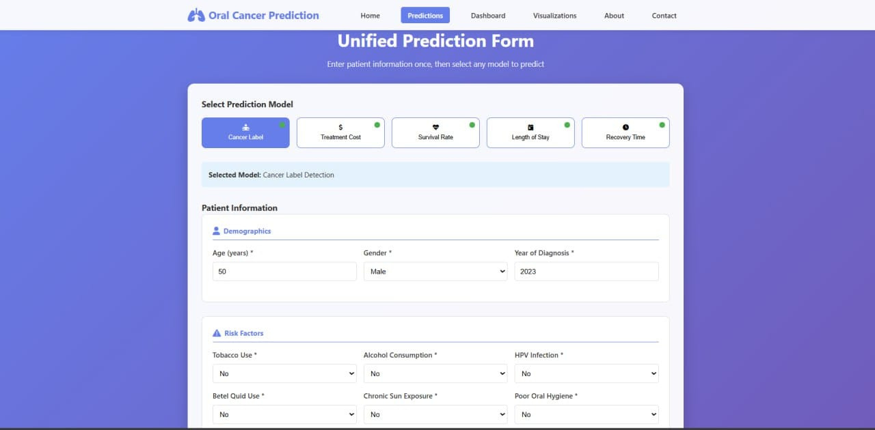
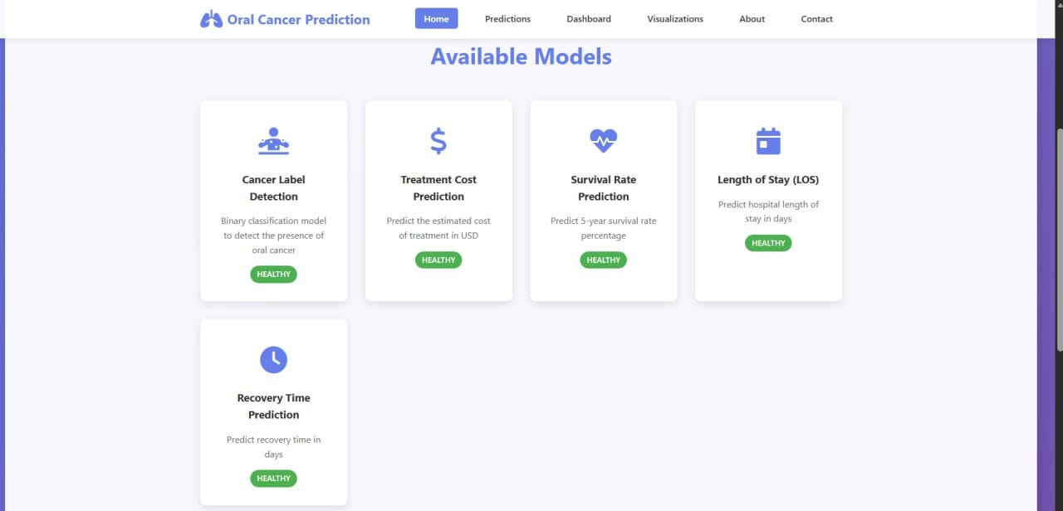
DEPLOYMENT
Home page

Slide 33
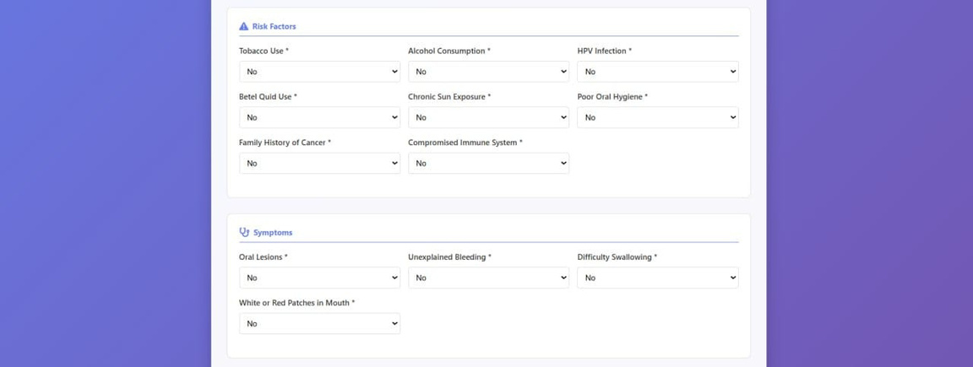
DEPLOYMENT
This is how and where inputs are added
After selecting the model type, the appropriate input features are supplied based on its requirements.

Slide 34
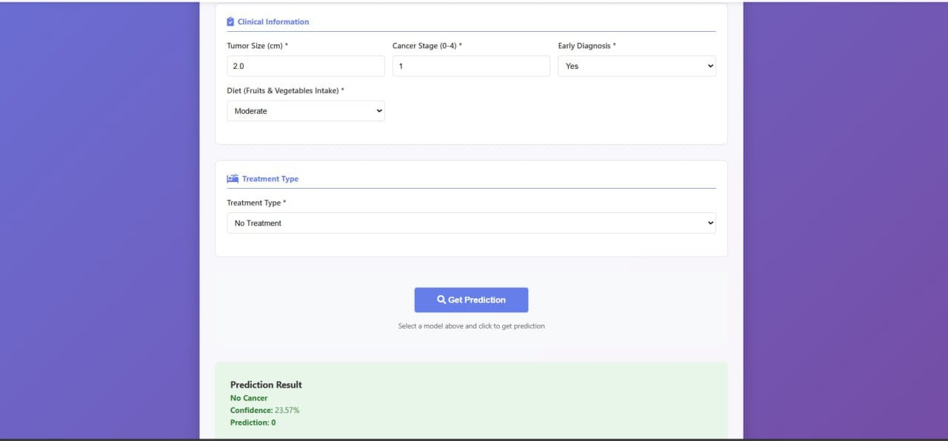
DEPLOYMENT
This is how the output is displayed

Slide 35
06
CONCLUSION

Slide 36
In this project, we addressed the critical challenge of predicting oral cancer risk using a collection of machine learning and deep learning models trained on real-world clinical data. The dataset required careful preprocessing to ensure reliable predictions, after which multiple models were developed to estimate key outcomes, including cancer label classification, recovery prediction, length of stay, treatment cost, and survival rate.
For the cancer classification task, logistic regression delivered the strongest performance, achieving 89.6% accuracy and a balanced ability to identify both cancer and non-cancer cases. Regression models supporting recovery, LOS, and survival prediction achieved exceptionally high R² values—most above 0.98—indicating strong predictive capability, while the cost model showed moderate performance due to naturally high variability in medical expenses. A deep learning model was also tested and showed very high explanatory power (R² = 0.98), confirming its value, though ensemble and linear models remained more stable and interpretable for clinical use.

Slide 37


Overall, these results demonstrate how predictive modeling can help support earlier detection, clinical decision-making, and resource planning in oncology. When combined with rigorous preprocessing, model selection, and evaluation, machine learning provides practical tools that can assist healthcare professionals in improving diagnosis, anticipating patient outcomes, and enhancing overall treatment management for oral cancer.

Slide 38











TOOLS

Slide 39

ANY QUESTIONS?

Slide 40

REFERENCES
Dataset:https://www.kaggle.com/datasets/ankushpanday2/oral-cancer-prediction-dataset
Pandas: https://pandas.pydata.org/docs/
Matplotlib: https://matplotlib.org/stable/index.html
Seaborn: https://seaborn.pydata.org/
Scikit-learn: http://scikit-learn.org/

Slide 41
THANK YOU.

